Slide 1
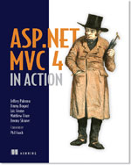



Keeping yourself DRY with Conventions
Jimmy Bogard
@jbogard
github.com/jbogard
jimmybogard.lostechies.com

Slide 2
What are conventions?

Slide 3
A set of coding policies applied and/or enforced across a codebase

Slide 4
Why should I care?

Slide 5
Survey of two projects
Project A
~6 years of development, 6-10 devs
>100 deployments to counties across Texas
ASP.NET MVC Preview 3 -> MVC 4
352 Controllers
1079 Actions
Project B
15 months of development, 6-10 devs
3 deployments to counties across Texas
78 Controllers
698 Actions

Slide 6
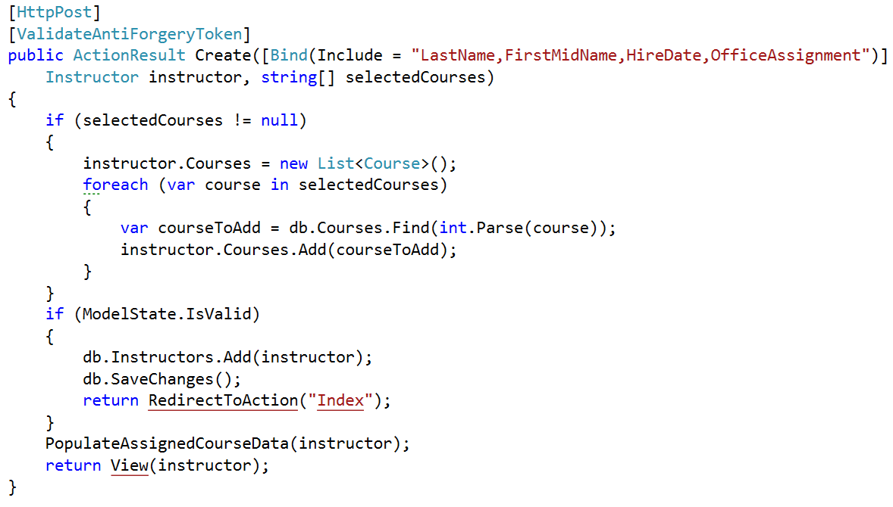
GETs/POSTs: Bad way

Slide 7
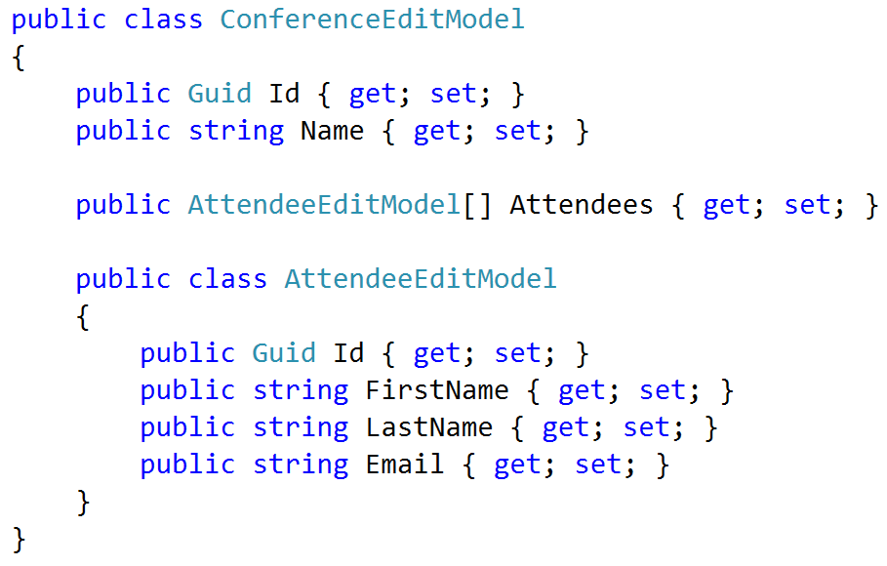
Cunning plan: View Models

Slide 8
Moment of panic
100s of controllers
100s of actions
100s of view models
100s of views

Slide 9


Slide 10
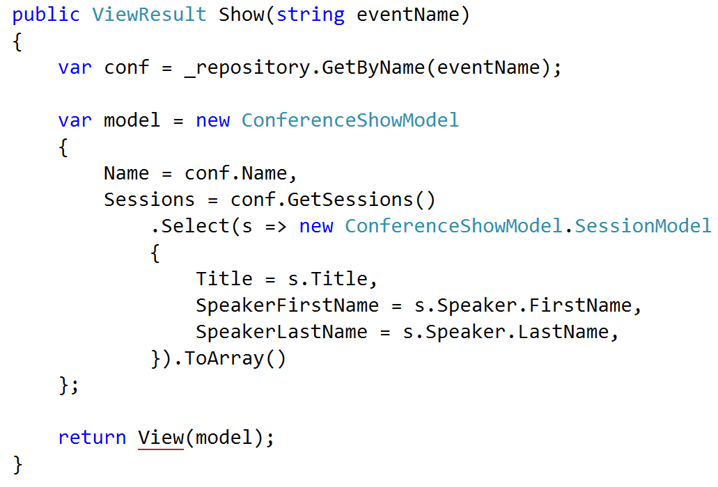
GET patterns

Slide 11
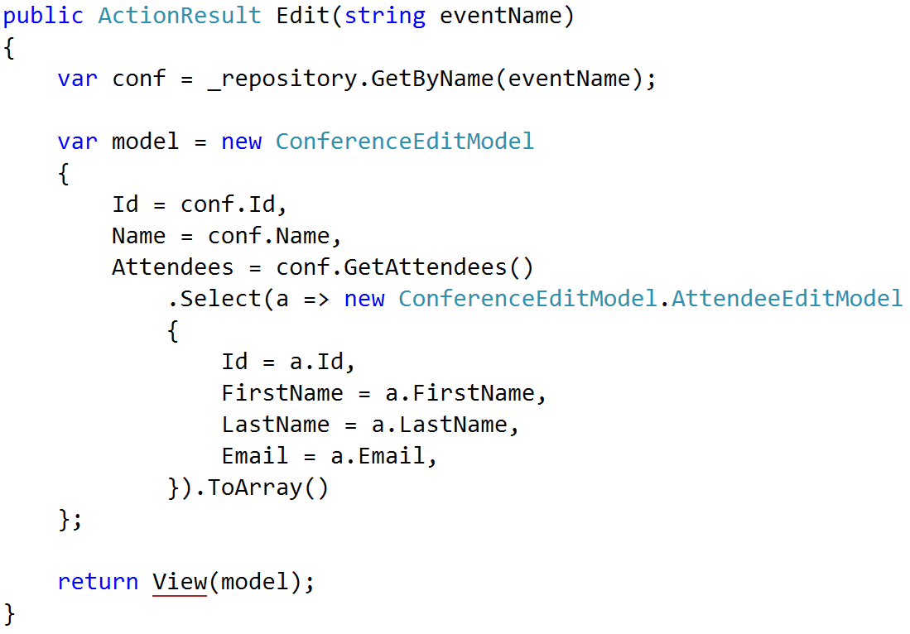
GET patterns

Slide 12
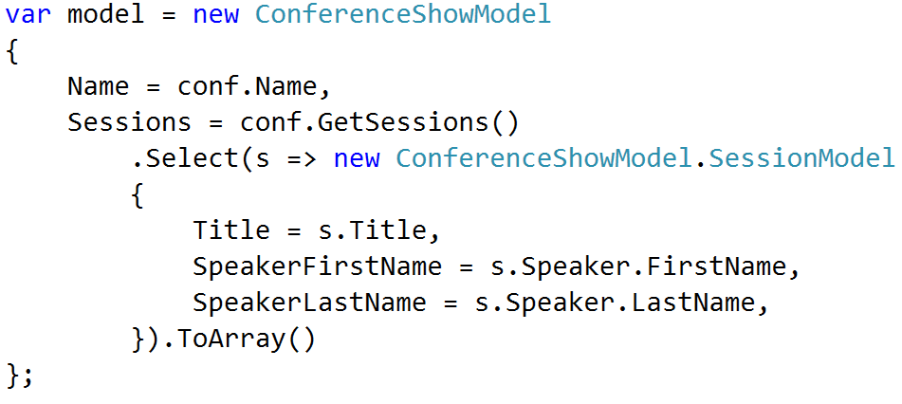
GET patterns ENHANCE

Slide 13
Policy
Match names exactly
Foo -> Foo
Bar -> Bar
Recognize Get methods
GetTotal() -> Total
Flatten navigations
Foo.Bar.Baz -> FooBarBaz
Handle the obvious

Slide 14
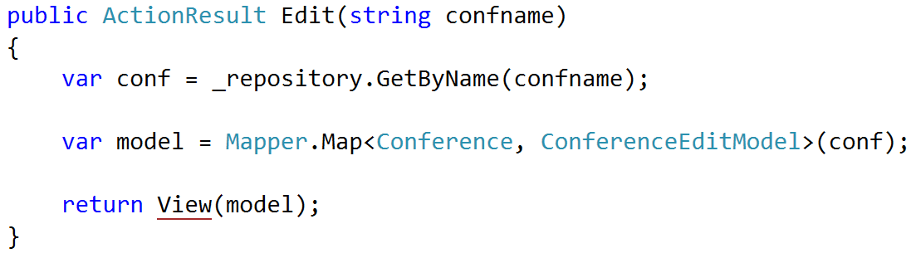
Result: AutoMapper

Slide 15
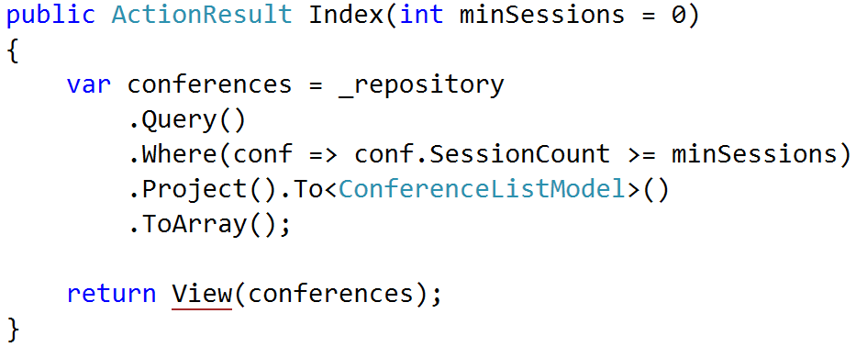
Result: AutoMapper

Slide 16
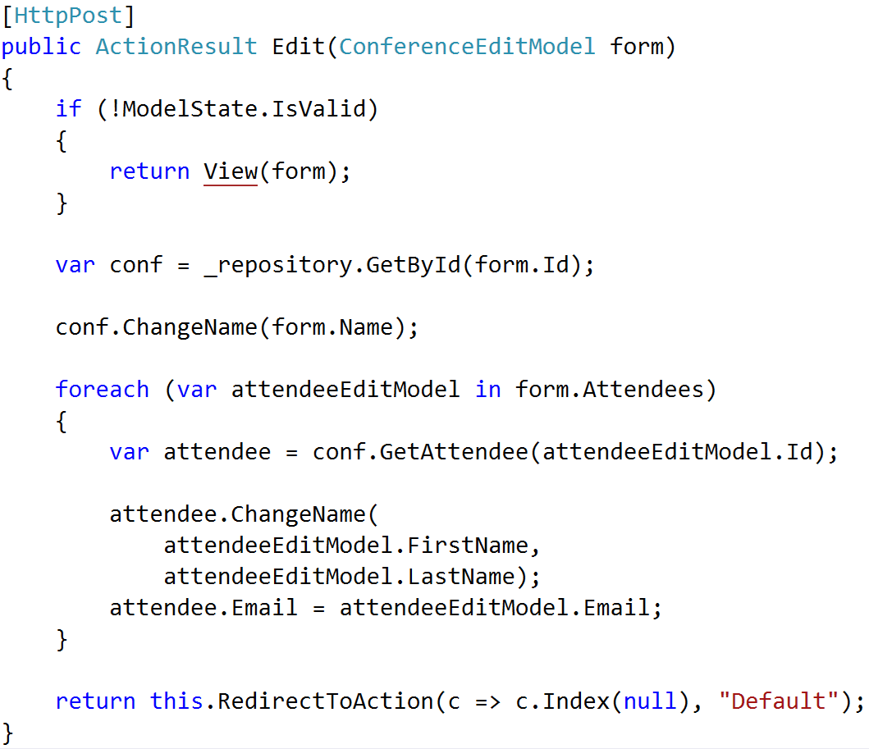
POST patterns

Slide 17
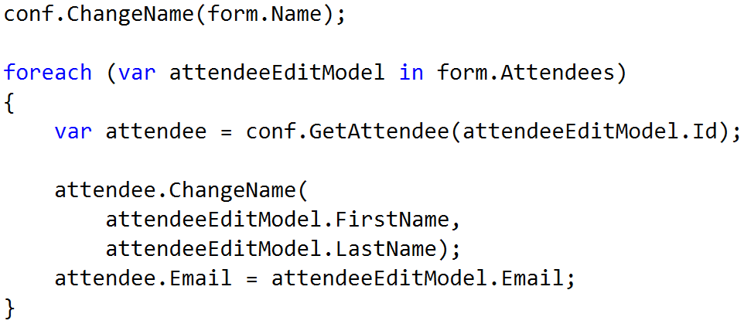
POST patterns ENHANCE

Slide 18
Policy
Behavioral entities
Logic much more complicated
No real patterns emerge
Leave it alone

Slide 19
Using Conventions

Slide 20
Implicit Conventions
Policy does not drive behavior
Policy enforced via rules
Similar to StyleCop, but one level up
Can use automated tests to enforce

Slide 21
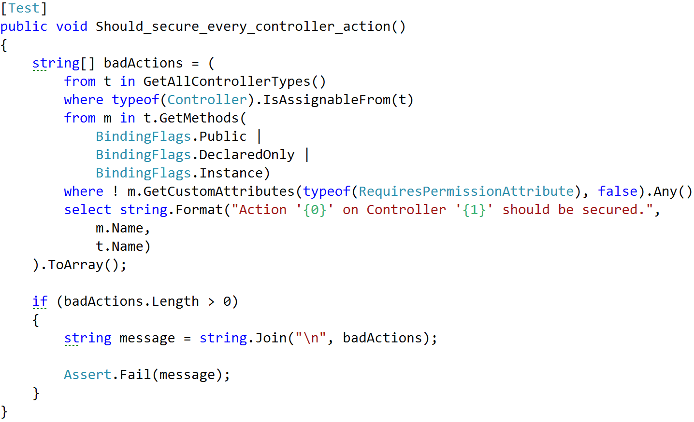
Example: Securing Actions

Slide 22
Other ideas
Type naming conventions
Controller/action names
Visibility rules
File organization

Slide 23
Explicit Conventions
Policy enforced by behavior
Opinionated rules
Customizable rules

Slide 24
Opinionated Conventions

Slide 25
Rule #1: Policies should be obvious, not magic

Slide 26
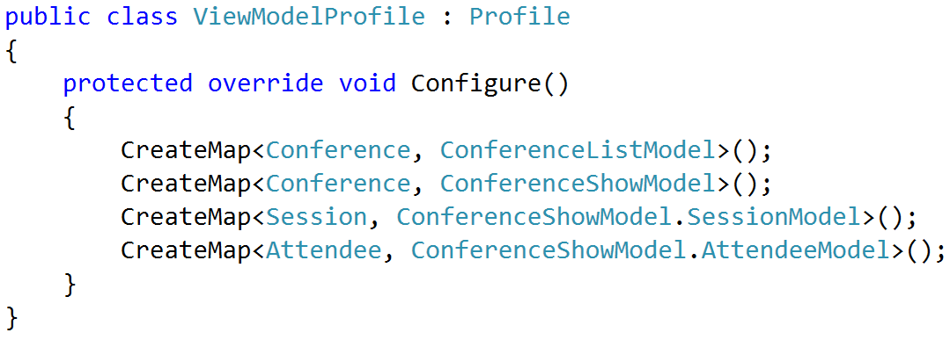
AutoMapper explicit config

Slide 27
Rule #2: Policies not driving behavior should be testable

Slide 28
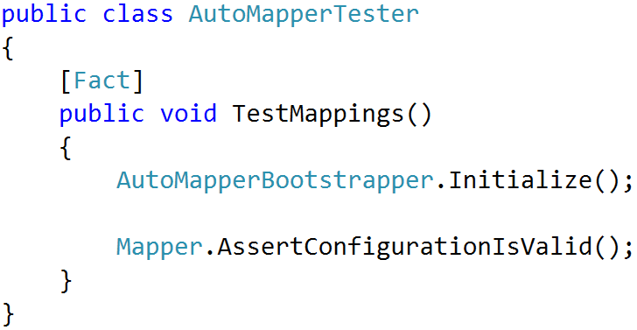
AutoMapper config validation

Slide 29
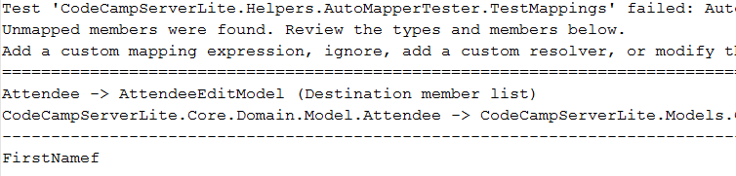
Rules violation

Slide 30
Rule #3: Policies should be debuggable

Slide 31
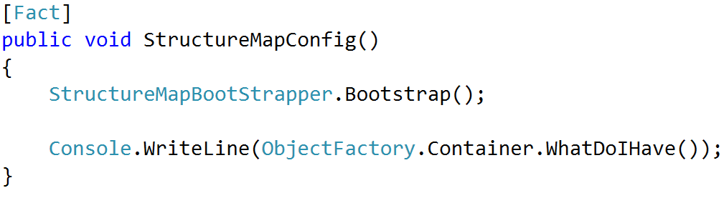
Examining StructureMap config

Slide 32
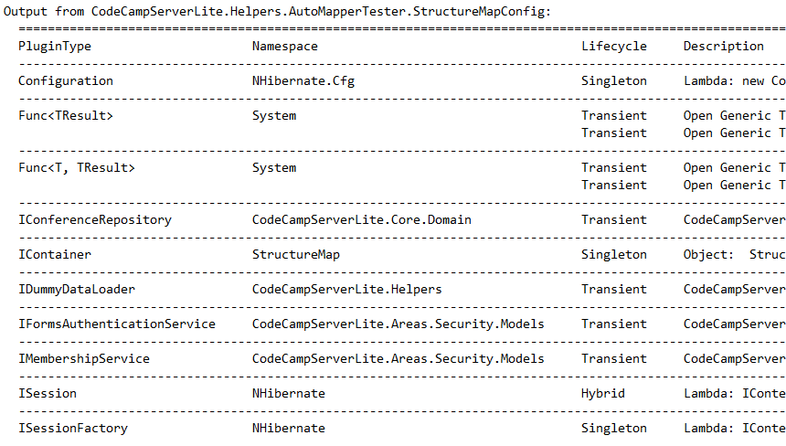
StructureMap config output

Slide 33
Real Example: HTML Conventions

Slide 34
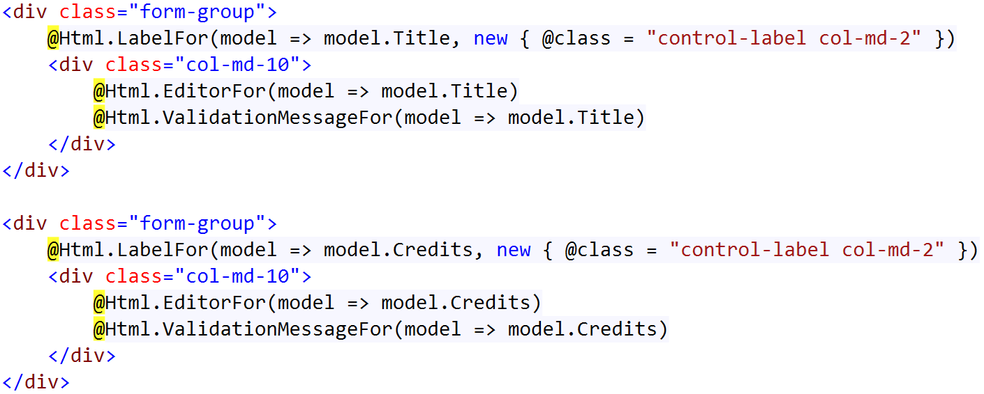
Problem: Dumb, repetitive code

Slide 35
Not a solution: templated helpers
Not easily composable
Not easily extensible
Not easily modifiable
Not code-centric

Slide 36
Solution: HTML Conventions
Element Request
Policies
Tag Model
String

Slide 37

Goal

Slide 38
Tooling
Razor views
HtmlTag library for tag model
FubuMVC conventions for policies

Slide 39
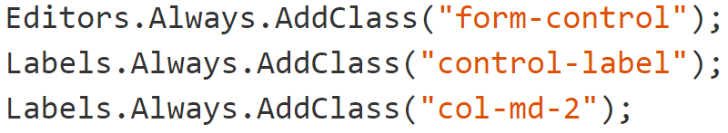
Establishing a baseline

Slide 40
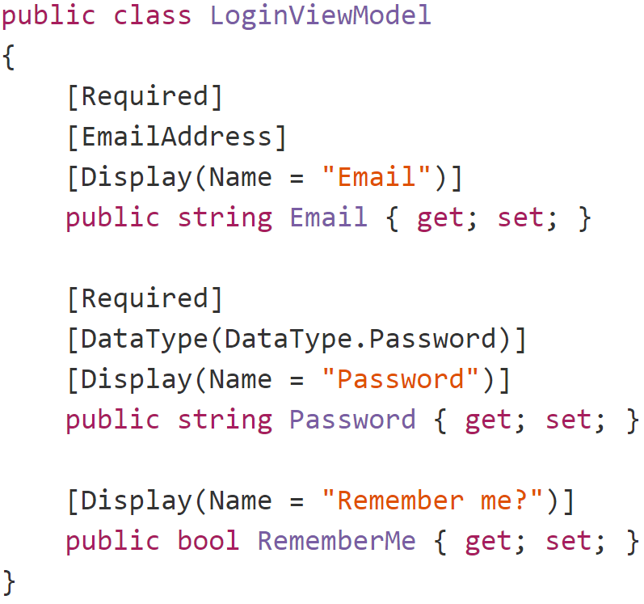
Sensible Defaults (Labels)

Slide 41
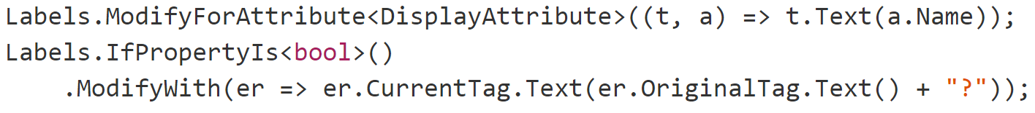
Sensible Defaults (Labels)

Slide 42
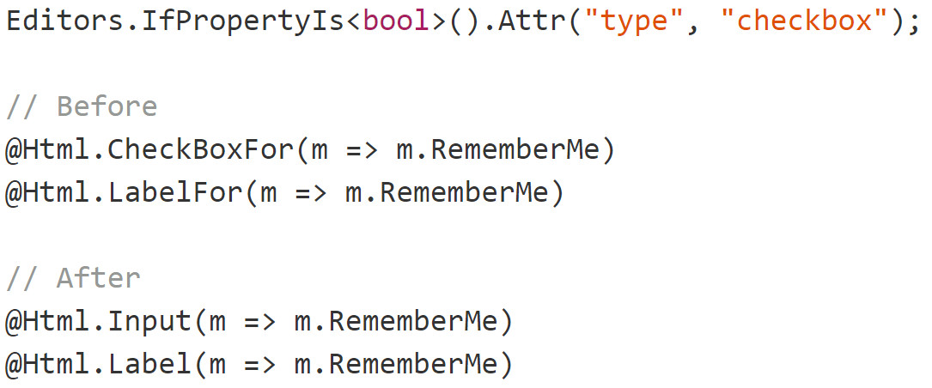
Sensible Defaults (inputs)

Slide 43
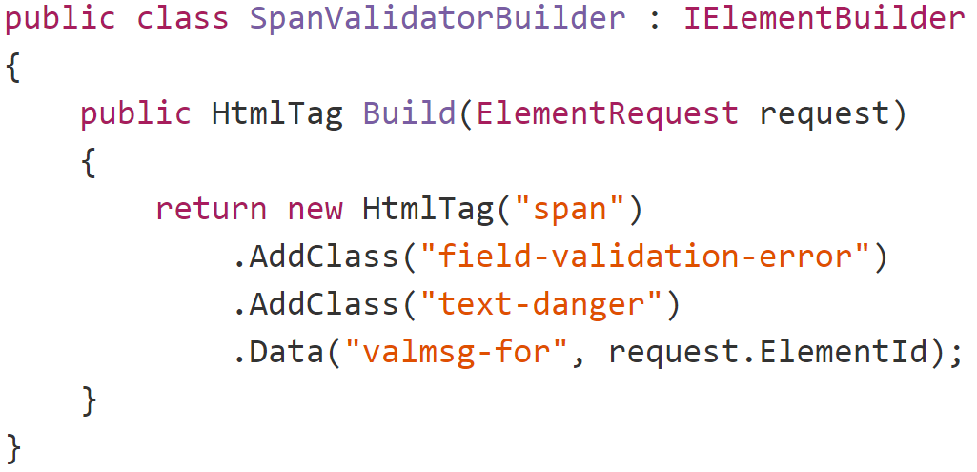
New Primitives (validation)

Slide 44
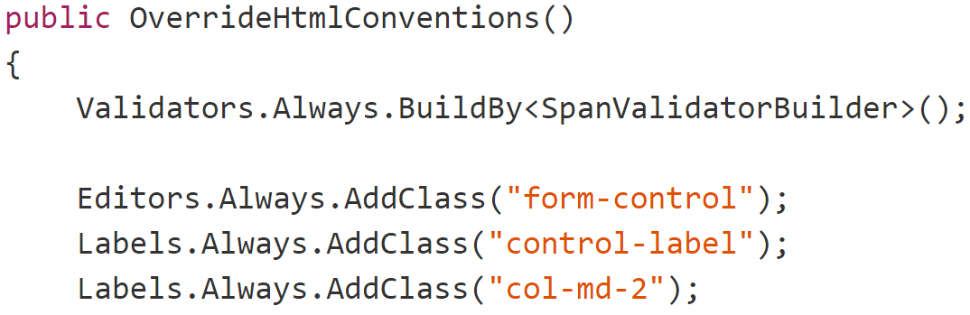
Building validators

Slide 45
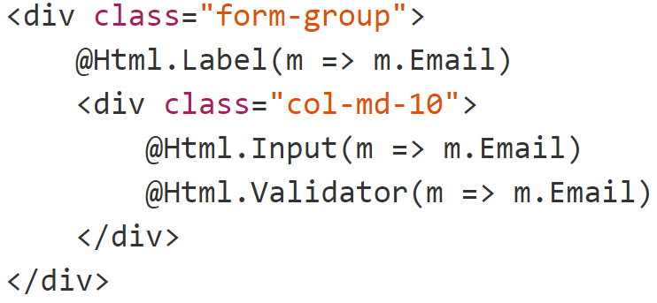
Labels, inputs and validators

Slide 46
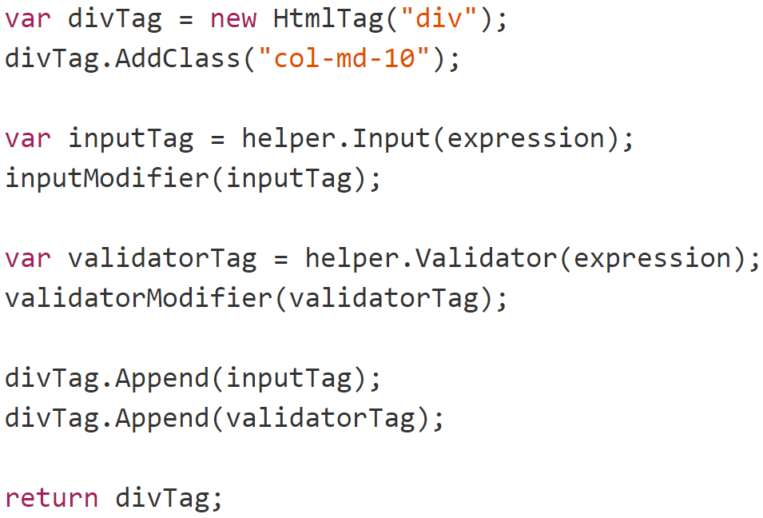
Larger primitives

Slide 47
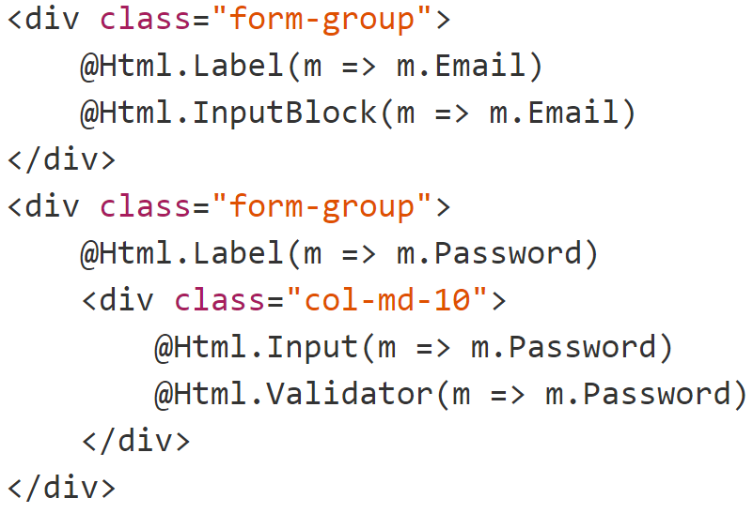
Larger primitives

Slide 48
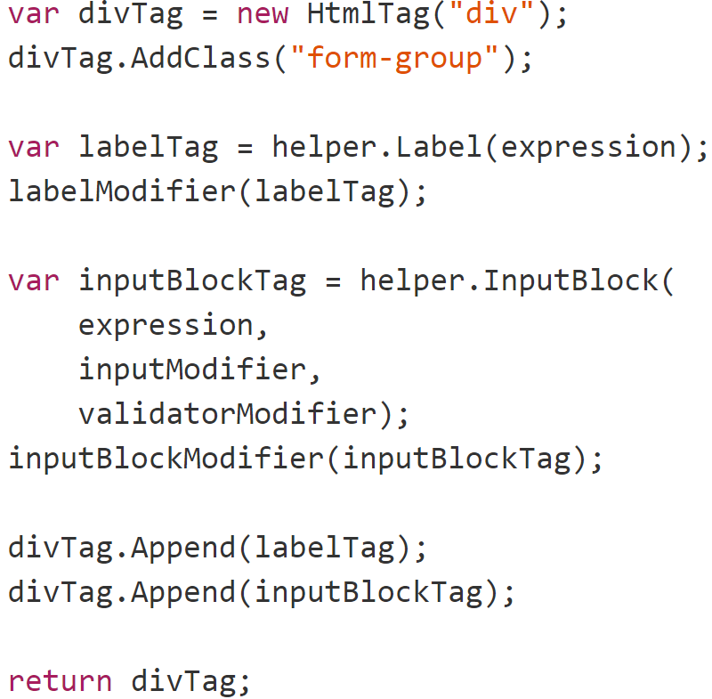
Final form

Slide 49
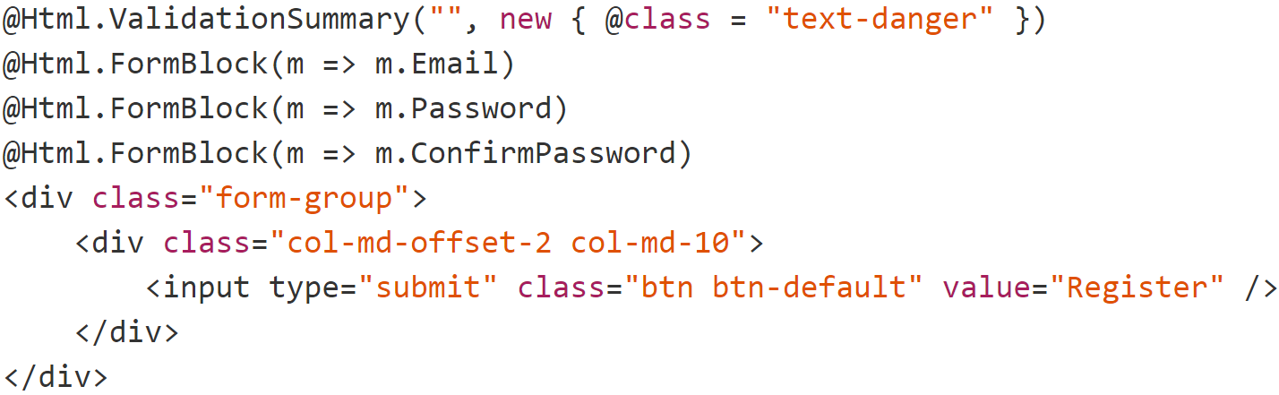
Final form

Slide 50
BUT WAIT I AM USING EMBERANGULAKNOCKBONE
(In which Jimmy gets sad)

Slide 51
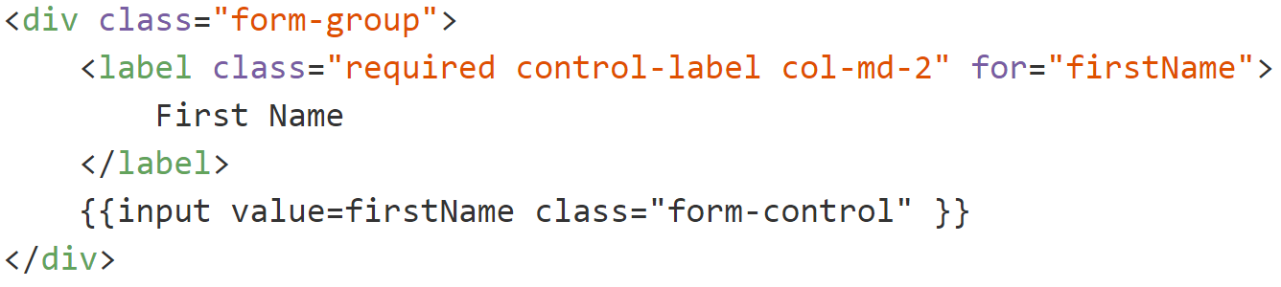
Back to the drawing board…

Slide 52
Problems
Browser
Server
POST
Rendering here
Metadata here
Templates, JS etc

Slide 53
Solution: Handlebarazor views
Razor View
Server
Razor Parser
Handlebars Template
Ember Binding
Client
Rendered HTML

Slide 54
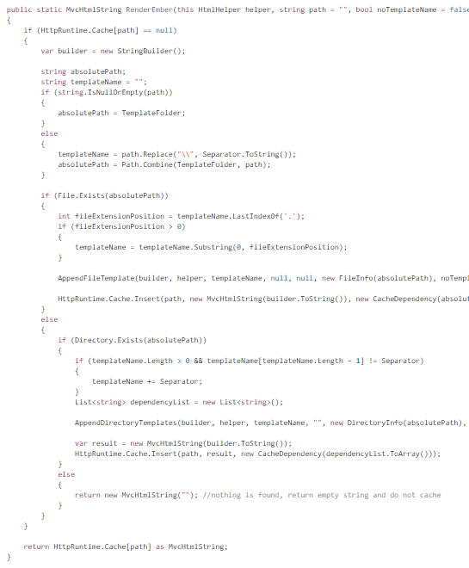
Pre-parsing step
https://gist.github.com/jbogard/47a8f67e5050bd10f2b8

Slide 55
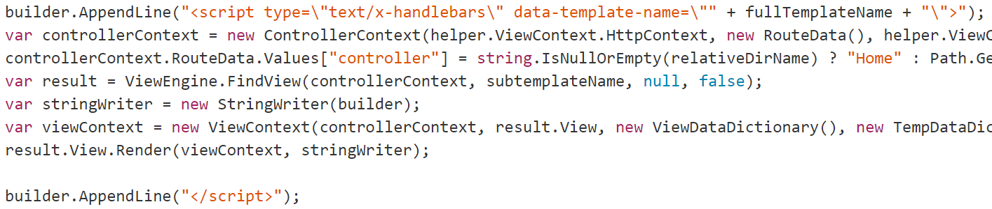
Embedding a template

Slide 56
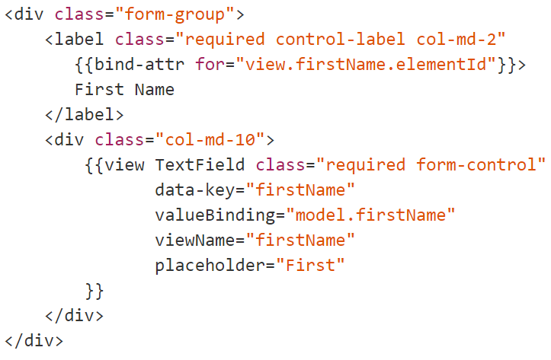

Target

Slide 57
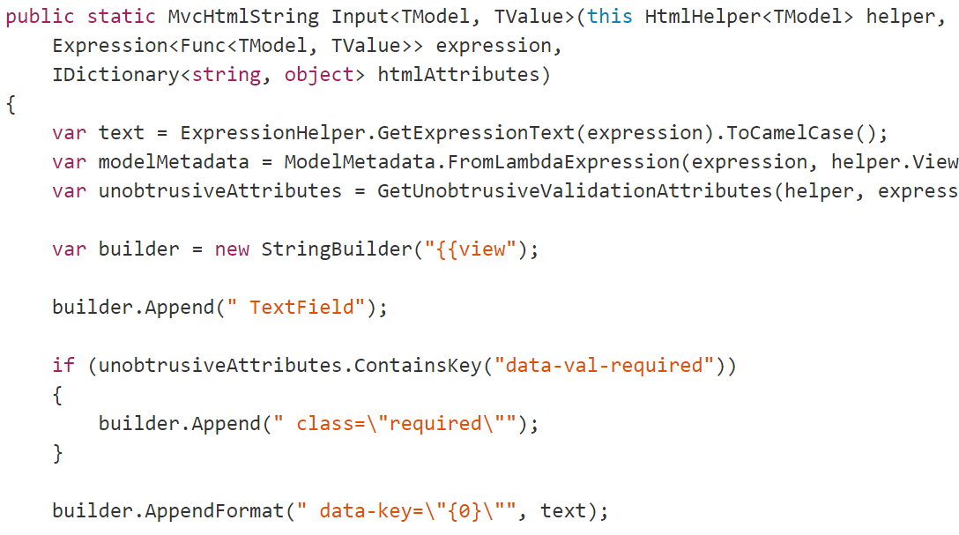
Building Inputs

Slide 58
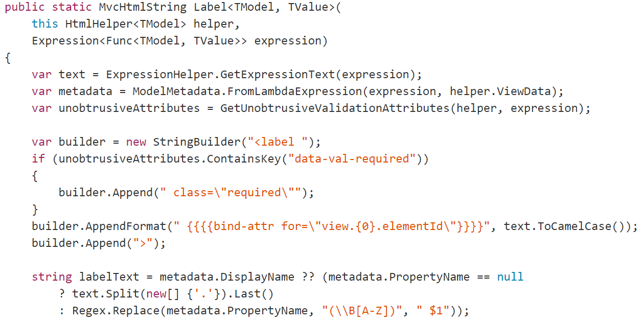
Building Labels

Slide 59
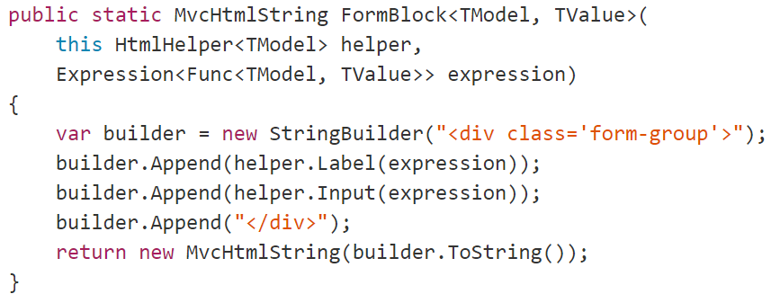
Building Form Blocks

Slide 60
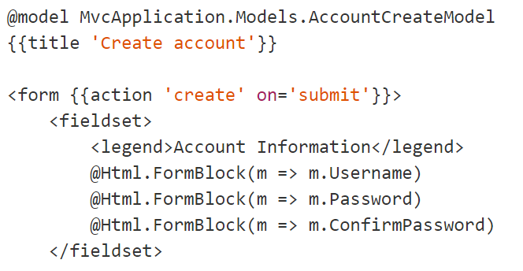
Final Form

Slide 61
Parting thoughts
Conventions = good
Magic = bad
Codegen is the devil

